Slide 1
Could morphological knowledge improve literacy in dyslexic children?
Professor Julia Carroll
Coventry University

Slide 2
Structure
What is morphology?
Is morphological awareness a strength or a weakness in dyslexic children?
  Are morphological difficulties associated with phonological difficulties?
Is use of morphological strategies in literacy associated with literacy success?
  Do other children with phonological difficulties use morphological strategies?
Are morphological approaches successful with dyslexic children?

Slide 3
Morphology
Morpheme = smallest meaningful unit
  Inflectional morphemes:
  [DOG][S] = 2 morphemes
  noun root plural suffix
  Derivational morphemes
  [inter] [rupt]
  Prefix root

Slide 4
Morphemes vary in how productive they are
Bankrupt
Bankruptcy
Bankruptcies
Abrupt
Abruptly
Abruptness
Interrupt
Interrupts
Interrupting
Interrupted
Rupture
Rupturing
Ruptures
Ruptured
Corrupt
Corrupts
Corruptively
corruptible
Uninterrupted
Uninterruptedly
rupt
“to break or burst”
Incorruptible
incorruptibility
Disrupt
Disrupted
Disruption
Disruptively
Disruptiveness
Erupt
Erupting
Eruption
Eruptions
Taken from Henry, M. (2010), Vocabulogic website

Slide 5
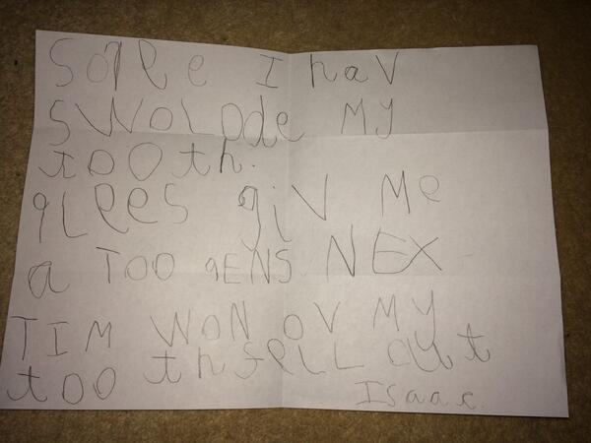
Letter to the tooth fairy (6 year old Isaac, typically developing)
‘Sorry I have swallowed my tooth.
Please give me a two pence next time
one of my teeth falls out.’
Isaac
Letters used:
Soree I hav swolode my tooth.
Plees giv me a too pens nex tim won ov
my tooth fell out

Slide 6
How do you spell ‘swallowed’?
Sounding out alone produces errors or alternative spellings:
  ‘swolode’
Consider the underlying structure of swallowed:
Swallowed = swallow + ed (known as inflectional morpheme)
  Vocabulary knowledge
  Knowledge of the rules of spelling affixes
  Knowledge of spelling of the root word

Slide 7
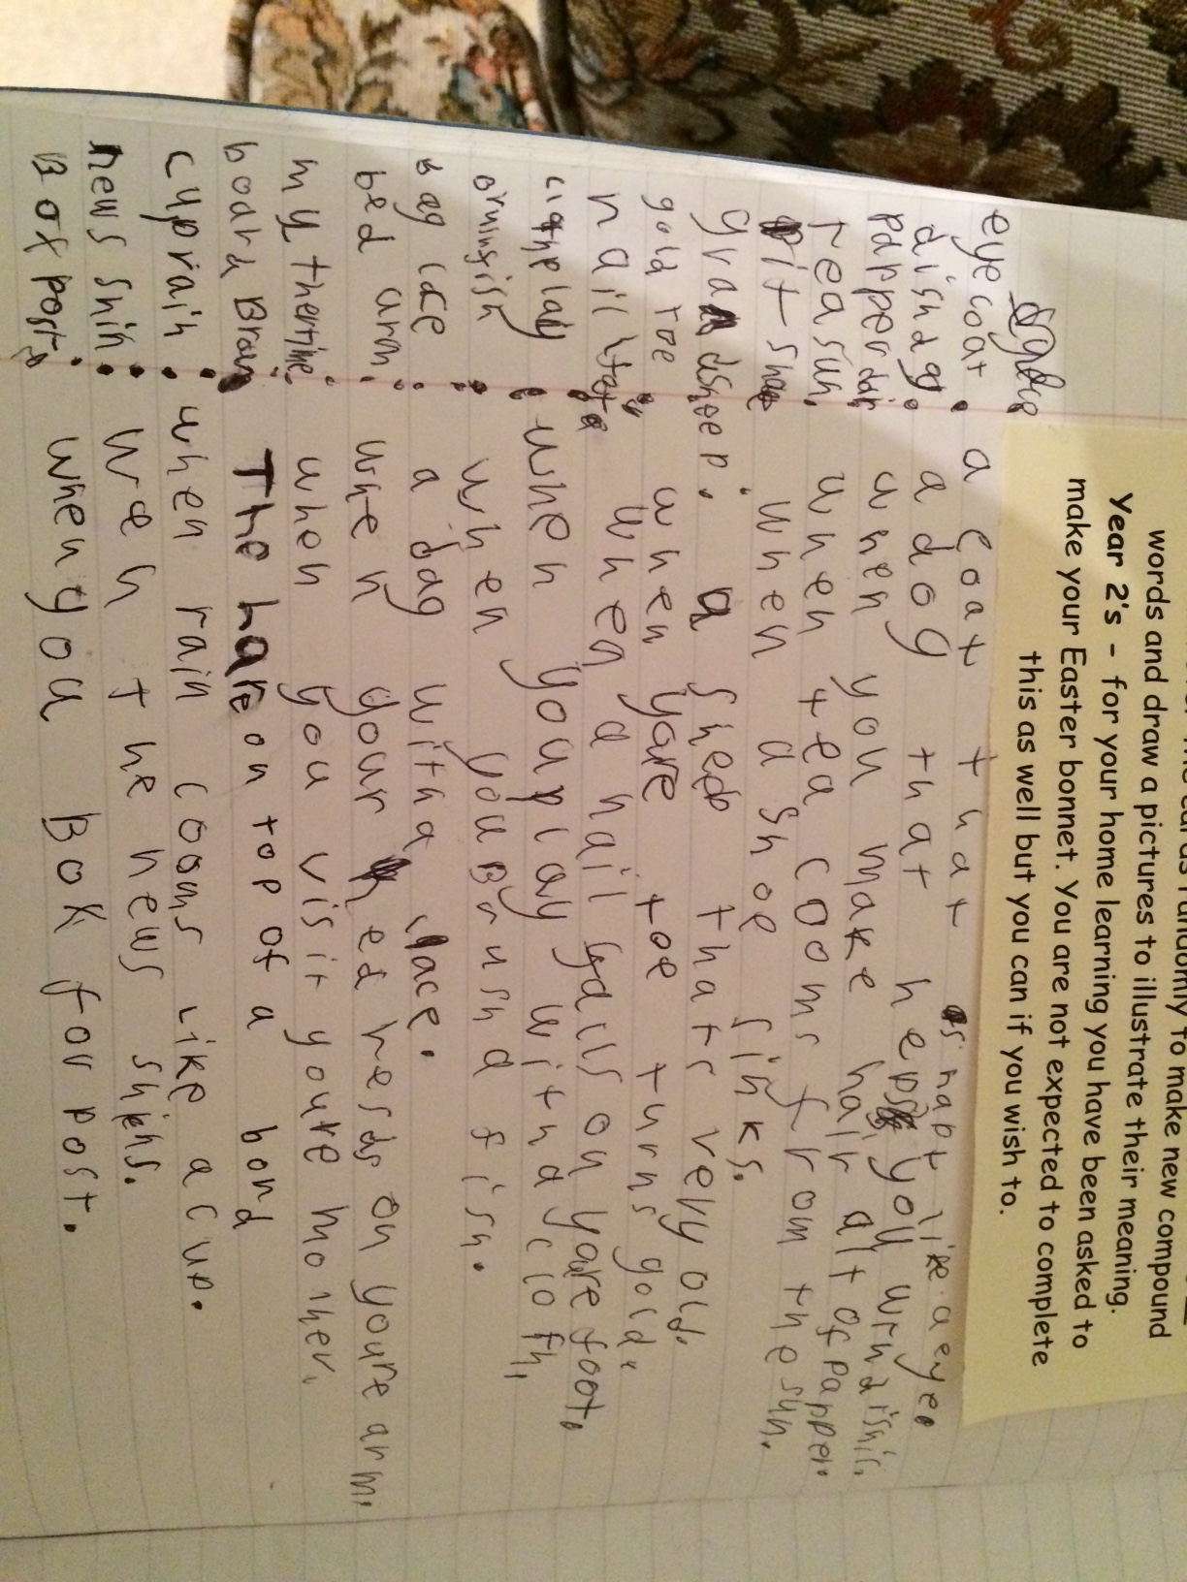
What do young children know about morphology?
“Eyecoat: a coat that is shapt like an eye”
“Dishdog: a dog that helps you with dishis”
Understands how words can combine to give new meanings
Doesn’t understand how spelling represents morphology

Slide 8
Advantages of morphology
English morphology is transparent.
  Disambiguates spelling. Bourassa & Treiman (2001),
  Gaustad & Kelly (2004)
  Jumped, rolled, hunted
    Past-tense morpheme spelled [ed]
    Pronounced /t/, /d/, /Id/.
English morphology is productive. Nagy et al (1994)
  Vocabulary development.
  [rain] in [rain][s], [rain][ed], [rain][y], [rain][water]
Notes:
English morphology is highly transparent. In fact, in many of the circumstances where spelling-to-sound rules are unclear, knowledge of morphology can disambiguate the spelling. For example, the past-tense morpheme is spelled <ed> in jumped, rolled and hunted, despite differing phonology.
English morphology is also highly productive in terms of meaning, offering vast potential for vocabulary development. For example, once the child understands the meaning of rain, it’s not such a huge leap to understand rains, rained, rainy and rainwater.

Slide 9
Structure
What is morphology?
Is morphological awareness a strength or a weakness in dyslexic children?
  Are morphological difficulties associated with phonological difficulties?
Do children with dyslexia use morphological strategies in reading and writing?
Are morphological approaches successful with dyslexic children?

Slide 10
Testing Morphological Awareness
Test understanding and production of morphologically complex words:
  Here is one cat, here are two ______
  Here is one wug, here are two _____
  Today the dog jumps over the fence, yesterday he ________
  The cat was the most gringy, it was the _________ cat.

Slide 11
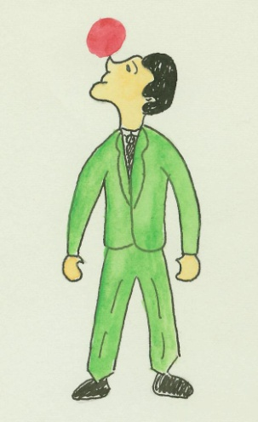
Dynamic Morphological Awareness
Q: This man’s job is to zib. What do you call someone whose job is to zib?
Prompt 1: This woman’s job is to bake. What do you call someone whose job is to bake? She is a .......?
Prompt 2: She is a baker
Prompt 3: When people do something as their job, we add a sound to end of the word – what sound do we add?
Prompt 4: This woman bakes. She is a baker . What sound did we add?
Prompt 5: We add an ‘er’ sound
Prompt 6: ‘baker’ and ‘zibber’

Slide 12
Coventry and Warwick Morphology and Phonology Project
A comparison of children with dyslexia and children with otitis media (repeated ear infections)
  Do they both show reading difficulties?
  Do they both show phonological difficulties?
  Could morphology help either of these groups to progress?

Slide 13
The Sample
36 dyslexic/poor readers, matched to 36 CA and RA controls
29 children with a history of Otitis Media, matched to CA and RA controls
8-10 year old children
 | Dyslexic | Dys-CA | Dys-RA | Otitis Media | OM-CA | OM-RA
Age | 109.1 | 109.1 | 87.8 | 110.4 | 110.0 | 101.9
Word reading age | 86.9 | 127.7 | 88.6 | 109.7 | 125.5 | 110.7
Verbal IQ (T-score) | 38.7 | 46.8 | 47.7 | 41.5 | 46.4 | 46.0
Nonverbal IQ (T-score) | 45.4 | 54.4 | 52.1 | 45.2 | 52.4 | 49.0

Slide 14
Results: Literacy Measures
 | Dyslexic | Dys-CA | Dys-RA | Otitis Media | OM-CA | OM-RA
YARC accuracy SS | 88.0 | 110.0 | 105.8 | 100.5 | 109.0 | 107.8
Spelling SS | 84.7 | 106.3 | 101.2 | 97.7 | 108.9 | 102.0
YARC compre-hension SS | 97.0 | 108.9 | 106.8 | 99.5 | 107.2 | 106.9
The dyslexic children are particularly impaired on word level literacy
The two impaired groups have similar levels of reading comprehension

Slide 15
Static and Dynamic Phonological Awareness
For dyslexic children: lower than CA but not RA controls

Slide 16
Static and Dynamic Morphological Awareness
More impaired than CA but not RA controls

Slide 17
What’s the relation between phonology skill and morphological skill?

Slide 18
The Warwick Speech and Literacy Project:
Recruit a varied, high risk sample at school entry
Including children with family risk of dyslexia and children with speech sound disorder
Contrast outcomes for children with different early profiles
  Good vs. poor phonological processing
  Good vs. poor language
  NB correlation of 0.40 between two factors
Carroll, Mundy & Cunningham (2014).
Developmental Science, 17, 727-742

Slide 19
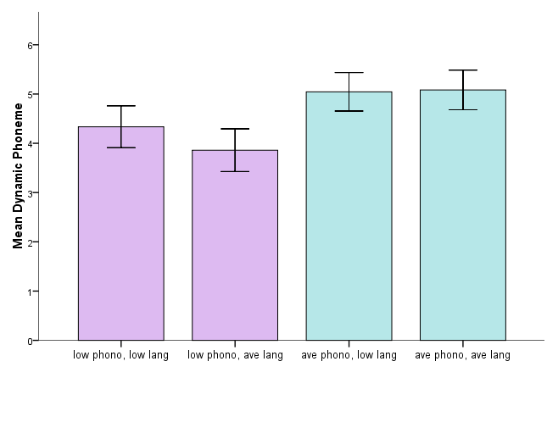
Children with low PP at T1 had significantly poorer PA at T3, F(1) = 5.2, p <.05, irrespective of language group, F(1) = .27, p = .61. Interaction F(1) = .37, p = .55
Cunningham & Carroll (2015).
Applied Psycholinguistics 36, 509-531

Slide 20
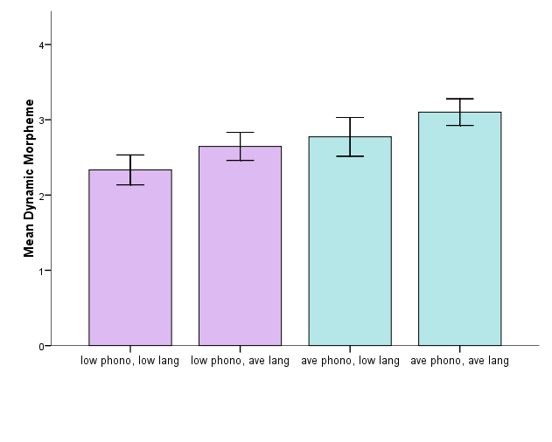
Children with poor PP at T1 had poorer morphological awareness at T3
No effect of language group on morphological awareness at T3
Cunningham & Carroll (2015).
Applied Psycholinguistics 36, 509-531

Slide 21
Summary so far…
We shouldn’t assume that morphological awareness is unimpaired in dyslexia
Children with dyslexia have morphological impairments similar to their phonological impairments
Children with weaknesses in phonological processing tend to have weaker morphological awareness later in development

Slide 22
Structure
What is morphology?
Is morphological awareness a strength or a weakness in dyslexic children?
  Are morphological difficulties associated with phonological difficulties?
Do children with dyslexia use morphological strategies in reading and writing?
Are morphological approaches successful with dyslexic children?

Slide 23
Word
Short-term memory probe task
Bees
Word
Boat
Sock
Garden
Hats
Bee
Pencil
Carpet
?
Notes:
This is what the short-term memory probe task looked like for participants
So participants were asked to remember a list of words, then they saw a probe word, and then they had to respond (with a keyboard press) to say whether or not the probe word was on the list.

Slide 24
Design
Hypothesis:
Overlap condition | Target lure | Probe | M | O&P | S
Morphological | Post | Postal | X | X | X
Pseudo-morphological | Met | Metal |  | X
Semantic | All | Everyone |  |  | X
Unrelated |  | Little
More confusable
Less Confusable
Are the different groups sensitive to shared morphology, beyond shared phonology?
Notes:
So the idea is to make people think they have seen a word that they haven’t.
The list contains a short target lure word, which overlaps with the longer word that is probed.
We manipulate the nature of the overlap between these words to see if those features influence rates of false alarms.
We expected words that share morphological overlap to be the most confusable – because they share orthographic, phonological, semantic and morphological features.
Those with pseudo-morphological overlap don’t share semantic or morphological features, but do share orthography and phonology.
Those with semantic overlap don’t share orthography or phonology, but do share semantics
Those that are unrelated have no overlap

Slide 25
Short Term Memory
Overlap p = 0.013
Group p = 0.047
Interaction p < 0.001
Younger children treat the pseudo-morphemes like morphemes, dyslexic and CA children don’t
Notes:
For dyslexia children, morphological and pseudo-morphological effects were significantly different from unrelated but semantic effect was not.
Dyslexic children differed from RA and CA matches ONLY in the morphological overlap condition.

Slide 26
Short Term Memory
Overlap p = 0.013
Group p = 0.047
Interaction p < 0.001
Dyslexic children find the morphemic overlap VERY confusing
Notes:
For dyslexia children, morphological and pseudo-morphological effects were significantly different from unrelated but semantic effect was not.
Dyslexic children differed from RA and CA matches ONLY in the morphological overlap condition.

Slide 27
Short Term Memory Probe
Children develop sensitivity to true morphemes slowly over time
Dyslexic children are sensitive to the difference between true morphemes and pseudo-morphemes
However, they also find the true morphemes very confusing in memory!

Slide 28
Structure
What is morphology?
Is morphological awareness a strength or a weakness in dyslexic children?
  Are morphological difficulties associated with phonological difficulties?
Do children with dyslexia use morphological strategies in reading and writing?
Are morphological approaches successful with dyslexic children?

Slide 29
Reading Sentences
Eye tracking methodology
  Measure how long participants look at different types of errors
Pseudohomophones (sound right, look wrong)
The village shop will have [clozed/closed] by tea time.
(not too disruptive if you sound most words out)
Overregularisations (contain existing morphemes)
Sophie will not have [eated/eaten] all of her dinner.
(not too disruptive if you decompose into morphemes)

Slide 30
Eye Tracking results
Multiple measures used – total duration here
Dyslexic group less disrupted by pseudo-homophones
Dyslexics rely more on sounding out
No differences on over-regularisations
*

Slide 31
Nonword Spelling
Prior work looked at awareness of morphology. But to what extent do children use morphological clues when writing?
  Compare words matched on phonological structure
  Sentence context gave clues as to morphological structure and therefore spelling:
Control:
The two girls ____(hax) in the park.
She called her pet rat ____________(Poama)
Morphological
The two girls dack in the park, one has to go home so the other girl _________ alone. (dacks)
A person who soams is a _____________(soamer)
Breadmore & Carroll (in press). Applied Psycholinguistics

Slide 32
Inflection and derivation
Inflection e.g., dogs, walked
  Primarily grammatical, syntactic meaning
  Speech good by 4 years old (Berko, 1958)
Derivation e.g., unhappiness, drinkable
  Change part of speech and lexical meaning
  Less productive and transparent
  Speech not secure until 8-9 years
  (Anglin, 1993; Tyler & Nagy, 1989)
Breadmore & Carroll (in press). Applied Psycholinguistics

Slide 33
Nonword Spelling Stimuli
Inflection | Pree-prees Whilp-whilps’ Dreep-dreeped Gringy-gringiest | +s +’s, +s’ +ed +est +er | The two girls dack in the park, one has to go home so the other girl _________ alone. The first one was quite ghend but the next was even _________________.
Derivation | Deaver-deaverous Fomb-fombless Saughty-saughtiness Lagic-lagician | +ous +less +ness +cian +tion +sion +able | The man tried to kice the bird. It could be kiced. It was ________________. She wouldn’t jorse it with him. There was not point having the ____________.

Slide 34
Phonetic spelling score

Slide 35
Nonword Spelling: Suffix use
Breadmore & Carroll (2015). Applied Psycholinguistics

Slide 36
Do children with dyslexia use morphological strategies in reading and writing?
Yes, they do.
Find morphology confusing in a word memory task (must be using it in memory)
Their use of morphology in reading seems age-appropriate (all inflectional morphology), while they are less disrupted by pseudo-homophones
Their use of morphology in spelling is at the level expected for their reading age, less than CA controls

Slide 37
Structure
What is morphology?
Is morphological awareness a strength or a weakness in dyslexic children?
  Are morphological difficulties associated with phonological difficulties?
Do children with dyslexia use morphological strategies in reading and writing?
Are morphological approaches successful with dyslexic children?

Slide 38
Morphology in the national curriculum (revised 2014)
Year Group | Concepts and Terms
1 & 2 (age 5-7) | The prefix un- Suffixes –ness, -er, -ful, -less, -ly Root words, Compound words Past tense –ed ending
3 & 4 (age 7-9) | Prefixes auto-, anti- Word families (e.g. solve/ solution/ soluble) Verb inflections (standard English forms) Possessive –s
5 & 6 (age 9-11) | Suffixes –ate, -ise, -ity Verb prefixes dis-, de-, mis-, over-

Slide 39
Are morphological approaches successful in dyslexia?
Anecdotal evidence: yes
Analogical evidence: helpful with children who are deaf
  But a different type of phonological impairment
Meta Analysis: Goodwin & Ahn, 2010, 2013
  Morphological intervention is moderately effective for struggling readers (particularly speech & language problems)
  More effective when integrated into broader literacy tuition
  Significant improvements on comprehension and spelling, smaller on decoding

Slide 40
Conclusions: Could morphological knowledge improve literacy in dyslexic children?
Morphological awareness is not unimpaired in dyslexic children
However, dyslexic children do have some sensitivity to morphemes
Structured and systematic tuition including morphological awareness is likely to be useful.

Slide 41



Thanks to:
All my collaborators on these projects:
  Helen Breadmore, Anna Cunningham, Ian Mundy
All of the children, teachers and parents involved
My Funders:

