Slide 1
Language acquisition in relation to developmental dyslexia
Cross-linguistic perspectives
Lynne Duncan University of Dundee, UK

Slide 2
Brain regions involved in reading
Typical readers
Dyslexic readers
Paulesu et al (2014)

Slide 3
Cross-linguistic approach to early reading acquisition
Variation in
spoken language
written language
educational approach

Slide 4
Understanding early reading
Meaning
Written language
Spoken language
decoding units?
availability?
consistency?
Psycholinguistic Grain Size Theory (Ziegler & Goswami, 2005)

Slide 5
Early reading acquisition
educational differences
age of starting to read
teaching methods
spoken language differences
syllable complexity
written language differences
decoding depth

Slide 6
First language variation
Spoken Language
Syllables | Simple | CV syllables Few consonant clusters
 | Complex | CVC syllables Many consonant clusters
Written Language
Decoding depth | Shallow | 1 letter-1 phoneme Consistent correspondences
 | Deep | many letters–1 phoneme Inconsistent correspondences Contextual & morphological influences

Slide 7
European languages
Syllables | Decoding Depth
 | Shallow Deep
 | Simple | Finnish | Spanish Greek | Portuguese French
 | Complex |  | Norwegian Swedish Icelandic |  | Danish | English
Duncan et al (2013) Cognition

Slide 8
Co-authors
Philip Seymour & Sheila Baillie
University of Dundee, UK
Jacqueline Leybaert, Phillippe Mousty & Nathalie Genard
Free University of Brussels, Belgium
Carsten Elbro & Holger Juul
University of Copenhagen, Denmark
Costas Porpodas & Menelaos Sarris
University of Patras, Greece
Rannveig Lund, Baldur Sigurðsson & Anna S. Þráinsdóttir
Reykjavik Academy & University of Education, Iceland
São Luís Castro & Ana Sucena
University of Porto, Portugal
Sylvia Defior & Francisca Serrano
University of Granada, Spain

Slide 9
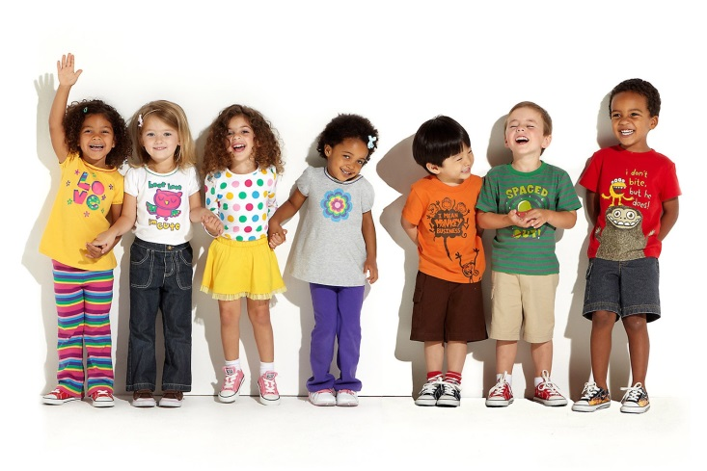
Participants
 | N | Age
English | 55 | 5;4
French | 20 | 6;6
Greek | 50 | 6;3
Icelandic | 33 | 6;2
Portuguese | 22 | 6;3
Spanish | 62 | 6;3

Slide 10
Tasks at beginning and end of first year
Letter knowledge
Word reading
Pseudoword reading
Phonological awareness
Notes:
English, Icelandic and French words had 1 or 2 syllables, and Greek, Portuguese and Spanish words had 2 or 3 syllables.

Slide 11
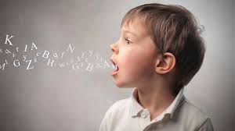
Spoken language differences
Duncan et al (2013)

Slide 12
Same-different matching
Do these sound the same?
marble-market
panther-bandage
penguin-padlock
syllable
rime
phoneme
garden-biscuit
✗

Slide 13
Common unit identification
Which sound is the same in….?
marble-market
cobweb-lobster
biscuit-bandage
syllable
rime
phoneme

Slide 14
Beginning of learning to read
syllable
rime
phoneme
syllable
rime
phoneme
Same-different matching
Common unit identification

Slide 15
After 1 year of learning to read
Common Unit Identification
syllable
rime
phoneme

Slide 16
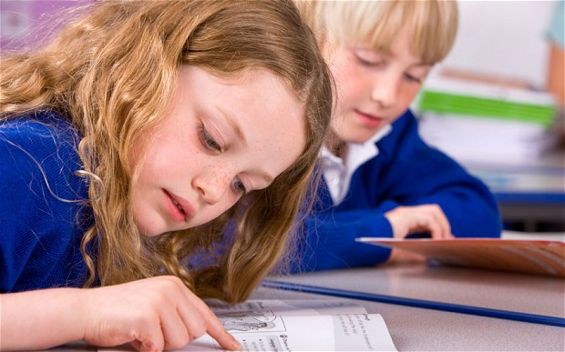
Educational differences
Belgian data

Slide 17
Whole-word vs. phonics instruction
Common Unit Identification
syllable
rime
phoneme

Slide 18
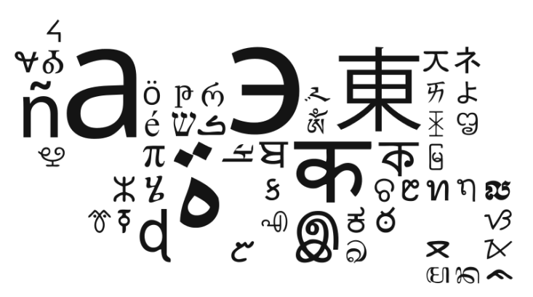
Written language differences
English & Icelandic data

Slide 19
Letter knowledge

Slide 20
Letters & reading words
English

Slide 21
Letters & reading words
Icelandic

Slide 22
Letters & reading pseudowords
English

Slide 23
Cross-language comparison simple vs complex words

Slide 24
Complexity effect for words at end of year 1
Language
% Difference
Finnish
1.76
Greek
6.04
Spanish
4.96
French
13.96
Portuguese
12.05
Icelandic
16.67
English
36.49

Slide 25
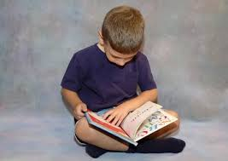
Tracing the foundations of developmental dyslexia
Duncan, Seymour, Baillie & Gray (2008)

Slide 26
Lower-case letter knowledge

Slide 27
Word reading

Slide 28
Simple words

Slide 29
Understanding early reading
Meaning
Written language
Spoken language
availability
consistency
decoding units
Psycholinguistic Grain Size Theory (Ziegler & Goswami, 2005)

Slide 30
Conclusions
Developmental sequence in typical and dyslexic reading development is influenced by
first language
literacy instruction
Cross-language comparison of typical acquisition and growth can guide assessment and intervention in dyslexia

Slide 31
Acknowledgements
Participating children & staff from schools around Europe

