Slide 1
The Dyslexia Archive:
Introducing a New Project in the History of Dyslexia
Notes:
Thanks to BA and BPS
Topic is dyslexia, a neurodevelopmental disorder that affects the process of learning to read, specifically to decode print and to spell.
Dyslexia is a Lifetime persistent disorder which needs intervention. If people with dyslexia are not properly supported then they can face a downward spiral of poor literacy, poor education and career prospects.
Dyslexia is therefore a problem for society.
But before we consider dyslexia, we need to consider reading. What does reading entail?

Slide 2
How did I/we get here?
Landmarks in the science of dyslexia

Slide 3
THE PIONEERS
The Dyslexia Movement in the UK

Slide 4
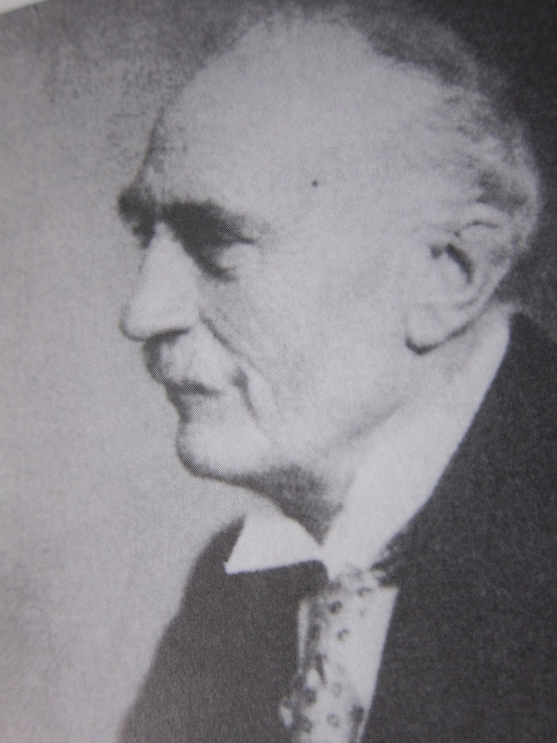
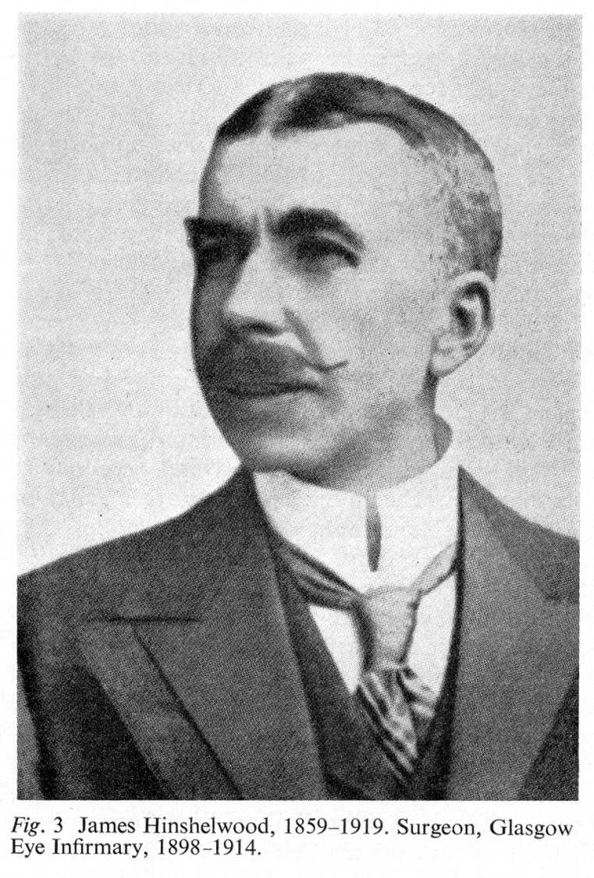
Congenital Word Blindness
William Pringle Morgan
1861-1934
James Hinshelwood
(1859-1919)
Notes:
Pringle Morgan
Case of 14-year-old boy who had not yet learned to read, yet showed normal intelligence and was generally adept at other activities typical of children of that age
Hinshelwood
letter reversals, and difficulties with spelling and reading comprehension

Slide 5
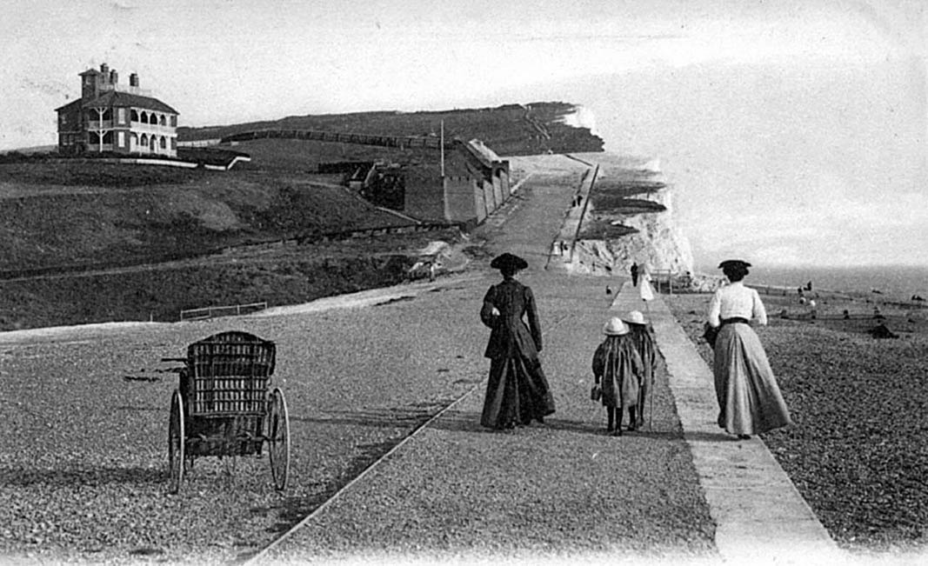
Seaford, c 1896

Slide 6
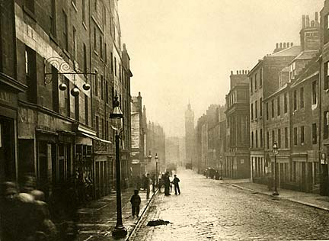
Glasgow, c 1896

Slide 7
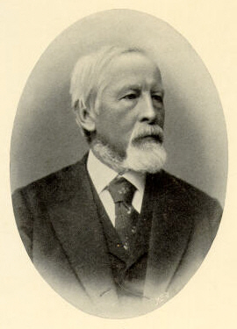
Adolph Kussmaul (1822-1902)

Slide 8
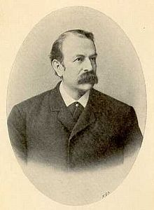
Rudolf Berlin (1833-97)

Slide 9
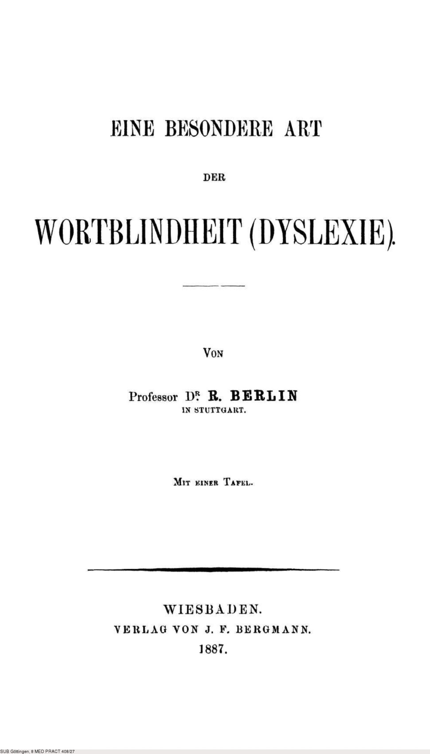

Slide 10
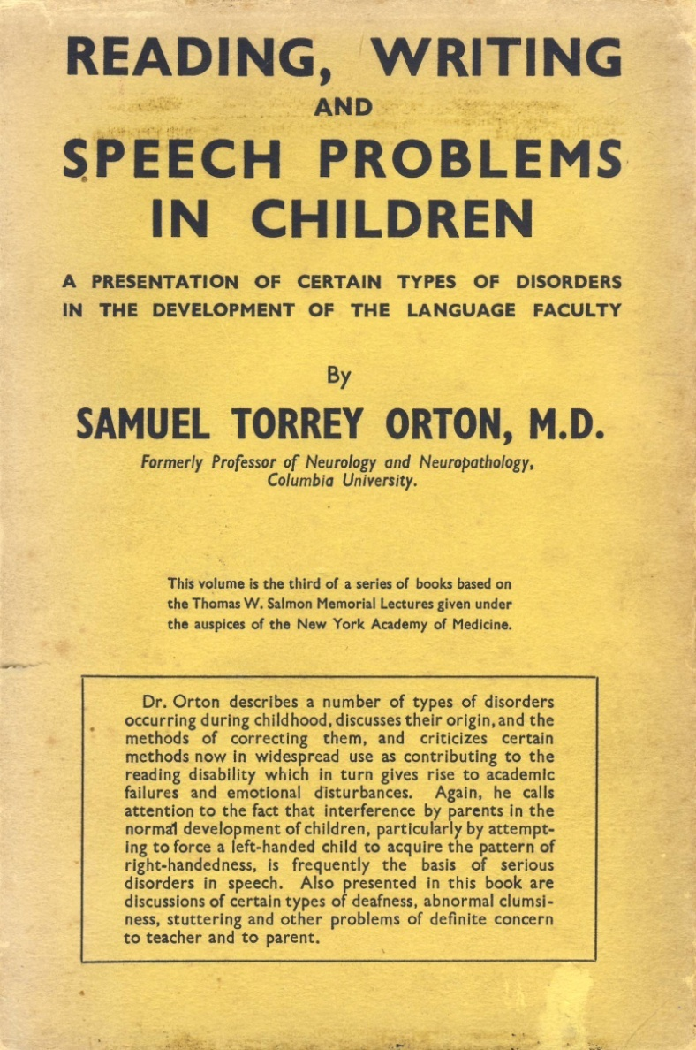
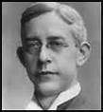
Strephosymbolia
Samuel Torrey Orton
(1879-1948) in 1925
Notes:
Strephosymbolia (meaning 'twisted signs') to describe individuals with dyslexia had difficulty associating the visual forms of words with their spoken forms.^{[6]}.^{[7]} He believed the condition was caused by the failure to establish hemispheric dominance in the brain.^{[8]} He also observed that the children he worked with were disproportionately left- or mixed-handed, although this finding has been difficult to replicate.^{[9]}
Influenced by the kinesthetic work of Helen Keller and Grace Fernald, and looking for a way to teach reading using both left and right brain functions,^{[6]}
Orton later worked with psychologist and educator Anna Gillingham to develop an educational intervention that pioneered the use of simultaneous multisensory instruction.^{[10]}

Slide 11
THE FOUNDERS
The Dyslexia Movement in the UK

Slide 12
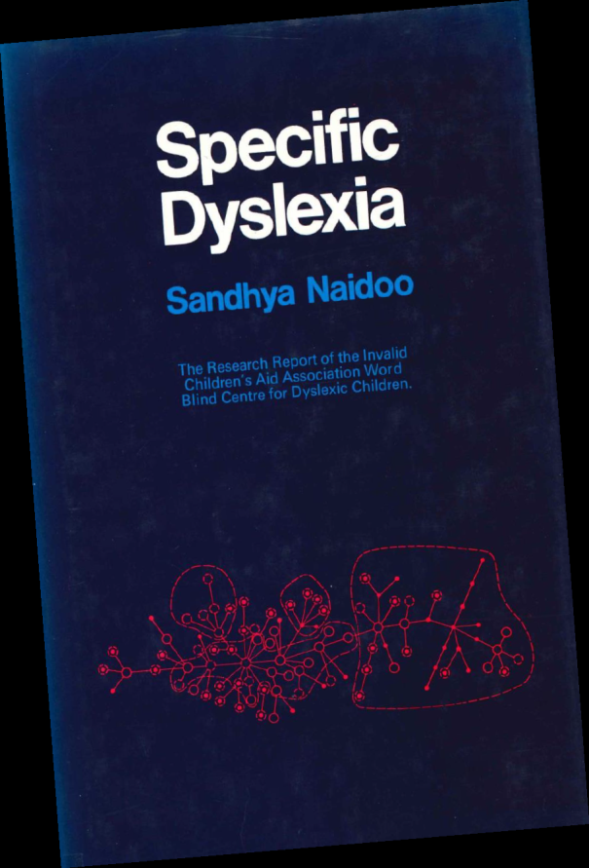
ICAA Word Blind Centre
Established in 1962 as a ‘Project’ funded by Invalid Children’s Aid Association (now ICAN).
Concerned with research and remediation
Director was Dr White Franklin who recruited a multidisciplinary team of neurologists, psychologists and educators

Slide 13
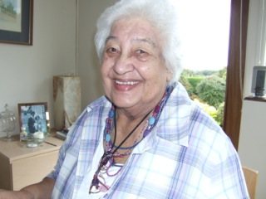
Sandhya Naidoo “my family was riddled with dyslexia”
Mother was Norwegian – in Norway her cousin went to a Word Blind School.
Trained in Education with Frank Schonell; became the Educational Psychologist at the ICAA Word Blind Centre following a period as a teacher of ‘difficult children’ in Hounslow LEA.
Philip Vernon introduced Sandhya as a mature student
to Oliver Zangwill who encouraged her to develop
her theory on Cerebral dominance and handedness
in dyslexia. She studied at Cambridge while a
mother of 3 children.
Published landmark text ‘Specific Dyslexia’.
Later was appointed first headteacher of
Dawn House School for children with Language
Impairment.

Slide 14
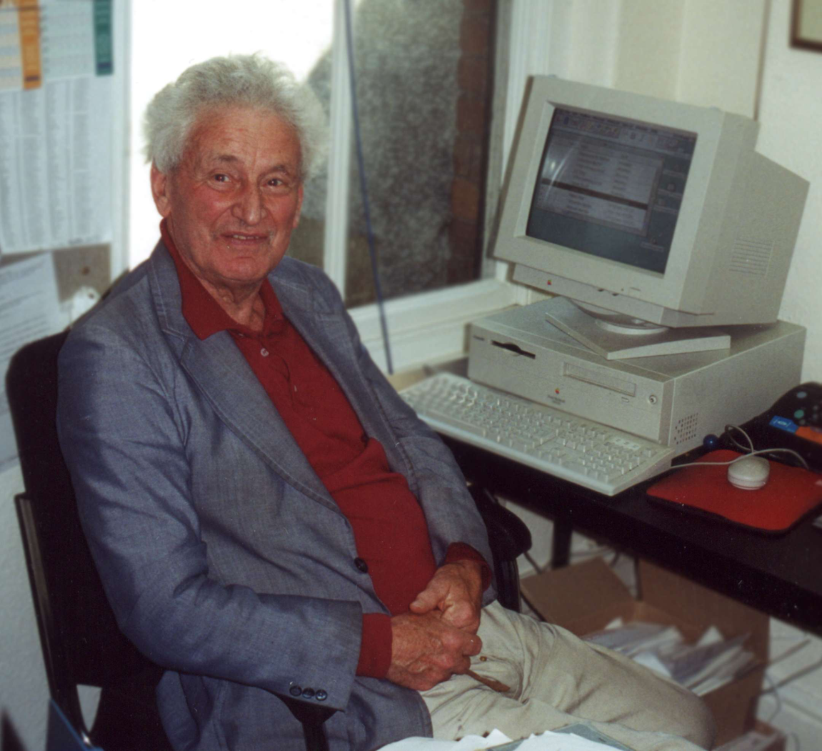
Professor Tim Miles OBE “Come and have a chat”
In his autobiographical account, Tim Miles acknowledged two children referred to him for help by the local child guidance clinic as providing the crucial clue to the nature of the disorder.
Tim’s initial cases had been patients referred to child guidance clinics and thought to have emotional problems
In the 60s he worked at the Word Blind Centre in London
Appointed OBE

Slide 15
Bangor Dyslexia Unit
After being appointed to Bangor University as a lecturer In the late 60s, Tim Miles collaborated with the Anglesey education committee by offering teaching to children with dyslexia in local schools.
He established the Bangor Dyslexia Unit to train teachers, in systematic multisensory methods of teaching and to organise their work in the community.
Long before dyslexia was recognised as a disability in higher education, he arranged for tutors to help students at his own university with written work
Tim established the first master's degree in dyslexia at Bangor, in association with the university department of education, with the aim of elevating the skills of practitioners of dyslexia.
He developed the Bangor Dyslexia Test, first published in 1982, and now translated into languages into several languages including Welsh and Japanese.
In 2009 the Dyslexia Unit was renamed the Miles Dyslexia Centre in honour of Professor Tim Miles OBE and the work he contributed to the world of Dyslexia

Slide 16
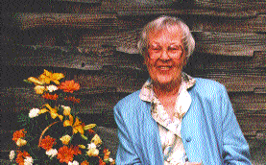
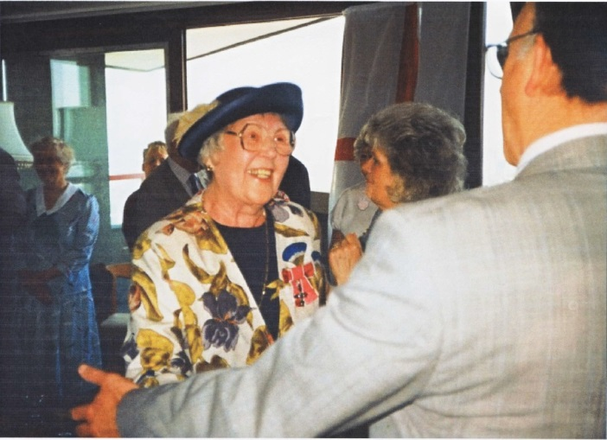
Marion Welchman “The Needle and Thread of Dyslexia”
It was Marion Welchman's search for help for her dyslexic son that led her to dyslexia, and what was to become a lifelong interest.
She invited Sally Childs from the Orton Clinic to come to the UK to train teachers in Orton-Gillingham Methods in 1969
Founded the British Dyslexia Association in 1972
Appointed MBE
Notes:
She was born Marion Eves in 1915, in Penarth, South Wales. After school in Penarth, she studied nursing at Cardiff Royal Infirmary and for the next 17 years nursing was her career, ending in Occupational Health in the Westinghouse Co in Chippenham during the Second World War. There she met her husband to be, an engineer, Dennis Welchman. They were married in 1943 and had three children, two girls, and a boy.
Howard, the youngest, was a bright boy who had incredible difficulties in learning at school. It was Marion Welchman's search for help for Howard that led her to dyslexia, and what was to become a lifelong interest.
Her early contacts were with the Invalid Children's Aid Association and their Word Blind Project in the early 1960s. Through them Welchman made contact with the Orton Dyslexia Society in the United States, who put her in touch with Agnes Wollf as a teacher for her son. This was such a success that Welchman decided to spread her knowledge and invited Sally Childs, a teacher who had worked with the Gillingham, Stillman teaching programme of multisensory teaching in the US, to run a training course for teachers in Bath.
It was Welchman's drive and determination that raised the money to set this up and the first course was held in 1969, with 13 state teachers and 10 from independent schools taking part. The demand for places was so great that the course was repeated for the next four years.
Having begun to get the teachers organised, Welchman turned her attention to the parents. By 1970 she had travelled the country talking to parents and setting up local associations of parents and teachers, the first being in Bath in 1966. The need for a national organisation was becoming urgent and, with Welchman's encouragement, eight local associations banded together to form the British Dyslexia Association in 1972. Twenty-five years later, the BDA has 100 local associations and over 75 corporate members.
After the death of her husband in 1984 she travelled widely and her personal contacts led to activity in places as far apart as South Africa, where a trust bears her name, and Singapore, where she was invited to the first meeting of the Singapore Dyslexia Association. When ill-health prevented her travelling, she maintained and made new contacts with parents and teachers in Nigeria and India and she eagerly supported the foundation of the European Dyslexia Association. She was delighted to be the first overseas recipient of the International Leadership Award of the Orton Dyslexia Society and very proud to be appointed MBE in 1992.
Her conviction that dyslexia has no boundaries led to her involvement in the setting up of the World Dyslexia Network Foundation in 1995 (her 80th year) and her dream of a truly international dyslexia family drew a step closer with the launch of the WDNF's first project - the Dyslexia Research Website to coincide with the 1896-1996 "100 Years of Dyslexia" campaign in November last year.
The BDA's 4th International Conference, held last month in York, and attracting over 600 delegates, was the first she had not been able to attend but a concert in her honour enabled the BDA to show their appreciation of this "mother from Bath who thought she could do something".
Marion Eves, charity administrator: born Penarth 6 June 1915; MBE 1992; married 1943 Dennis Welchman (died 1984; one son, two daughters); died Hatch End, Middlesex 19 April 1997.

Slide 17
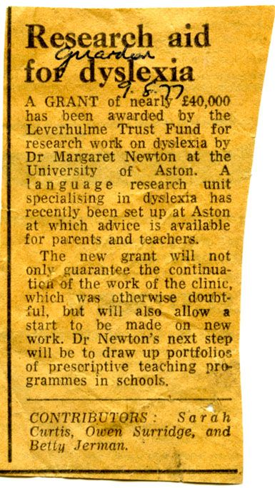
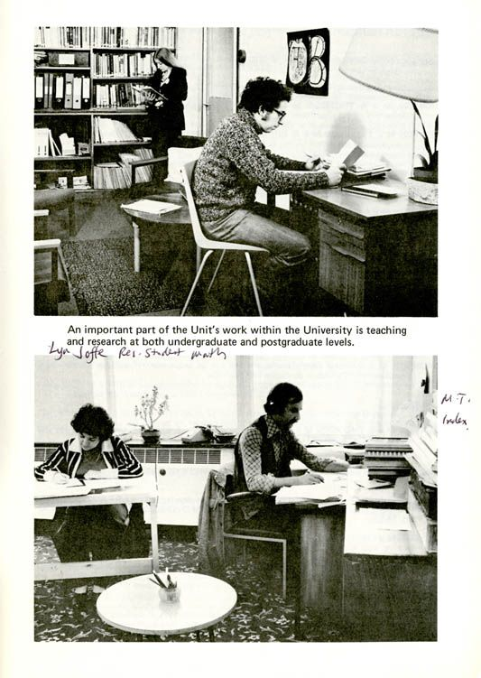
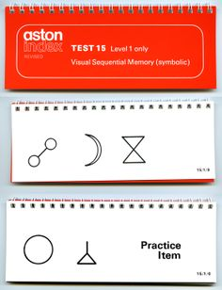
Margaret Newton Aston Dyslexia Unit (1977)

Slide 18
Dr Bevé Hornsby Barts Dyslexia Clinic
After qualifying in 1969 as a speech therapist, Bevé worked at the ‘Word Blind Clinic’ at St. Bartholomew’s Hospital
under the direction of Maisie Holt; two years later she took over when Maisie retired.
The Barts Dyslexia Clinic grew rapidly, expanding from a small corner of the department of Psychological Medicine to a department in its own right.
After retiring at the age of 65, Bevé set
up the Hornsby International Dyslexia Centre where she and her team continued to offer teacher training courses and professional services to children and adults with dyslexia.

Slide 19
“Reach for the Stars”
Bevé’s lasting legacy will be the book she wrote with Frula Shear, ‘Alpha to Omega’ that has been used by generations of teachers and dyslexia-therapists
Her last innovation was to found Hornsby House School to offer her own brand of education to typically developing children, alongside children at risk of reading difficulties.
Appointed MBE

Slide 20
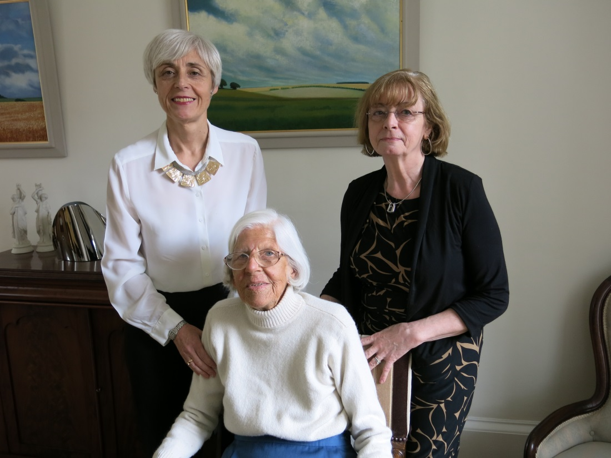
Helen Arkell ‘The Spellbinder’
Helen went through her childhood in Denmark thinking she was stupid. After her nephew in Norway was diagnosed as ‘word blind’ she visited Edith Norrie, herself dyslexic, who had developed a method to teach herself to read and founded the Word Blind Institute in Copenhagen.
It was then that Helen discovered she too was dyslexic. She founded the Helen Arkell Dyslexia Centre, though always self-effacing, attributed its success to Joy Pollock and Elisabeth Waller who taught there
Helen, with Bernadette McLean (right) Director of the HADC on her visit to provide an oral history for the Dyslexia Archive

Slide 21
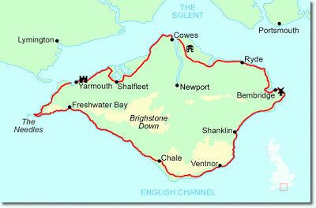
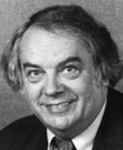
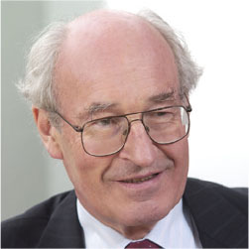
Isle of Wight Study
Two kinds of reading problem
Age discrepant: General Reading Backwardness (SRR)
IQ discrepant: specific reading retardation (GRB)
Language difficulties predated reading problems
Children with both SRR and GRB experienced language delays and difficulties
Rutter & Yule, 1973

Slide 22
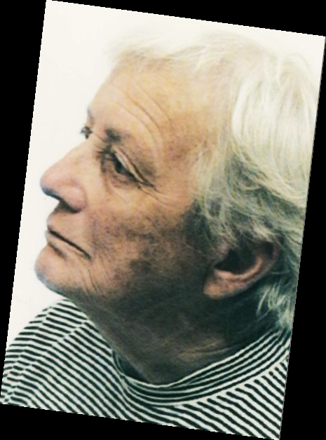
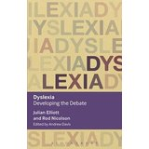
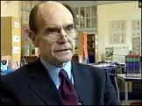
History of Dyslexia Policy
The Warnock Report (1978)
The Warnock Report in 1978, followed by the 1981 Education Act, introduced the idea of special educational needs (SEN), ‘statements’ of SEN, and an ‘integrative’ – which later became known as ‘inclusive’ – approach, based on common educational goals for all children regardless of their abilities or disabilities
The Rose Review (2009)
Led to a £10M investment in training dyslexia specialists

Slide 23
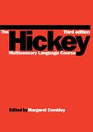
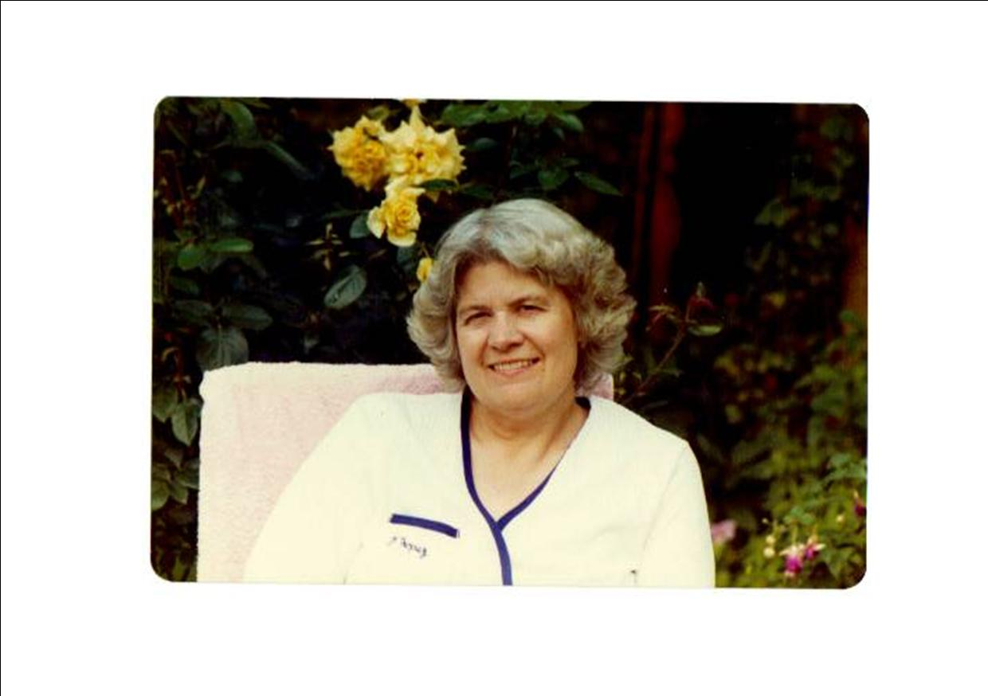
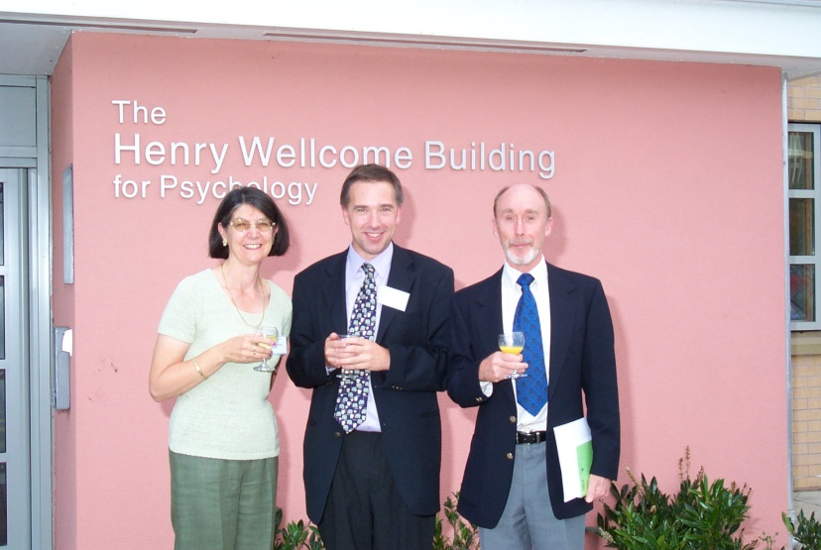
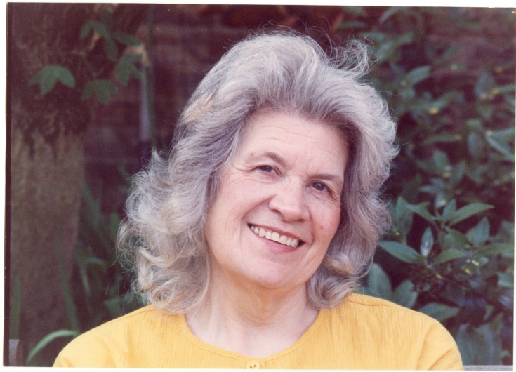
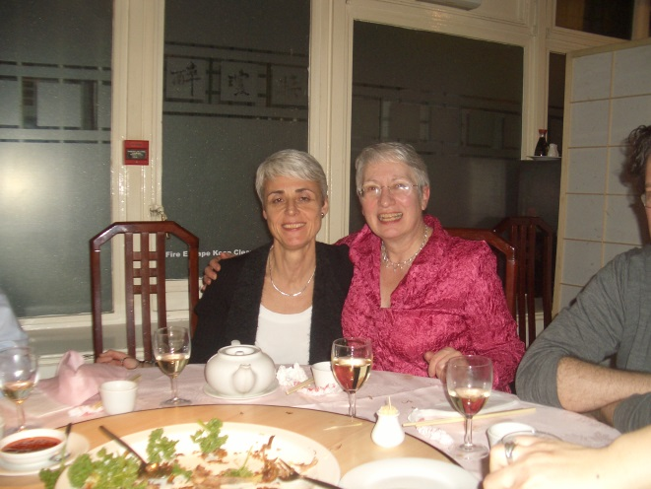
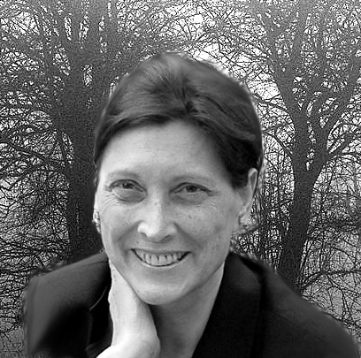
Oral Histories and Life Stories
Fisher, Wendy
Foster, Barbara
Hamilton-Fairley, Daphne
Thomson, Patience
Shear, Frula
Critchley, MacDonald
Green, Ross
Bramley, Walter
Augur, Jean
Augur, Frank
Hickey, Kathleen
John, Sister Mary
Stokes, Adrian
Matthew, Brother
Smith, Jennifer
Rutter, Mike
Yule, Bill
Pumphrey, Peter
Blunkett, David
Chasty, Harry
Friel, John
Ott, Philomena
Gardener, David
Matti, Jo
Newcombe, Freda
Bradley, Lynette
Reason, Rea
Thomson, Mike
Watkins, Bill
Cooke Ann

Slide 24
OUR TEAM AND plans
The Dyslexia Movement in the UK

Slide 25
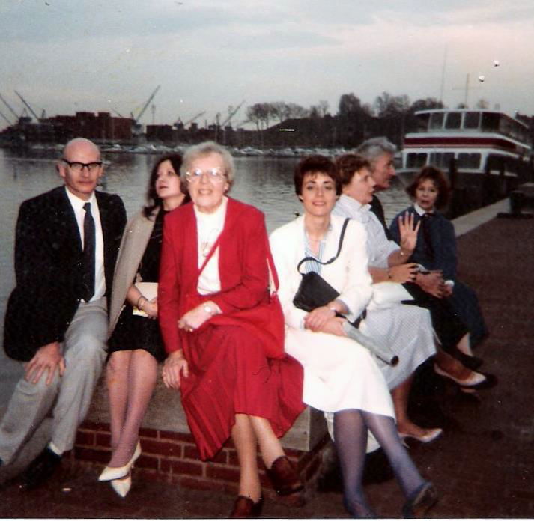
UK Dyslexia Specialists; Baltimore 1985
Harry Chasty (Dyslexia Institute)
Dorota Zdwienski (DI then Hornsby Centre)
Marion Welchman (BDA)
Maggie Snowling
(National Hospital/UCL)
Tim Miles (Bangor)
Margaret Newton (Aston Dyslexia Unit)
at the invitation of
Dr. Steve Chinn

Slide 26
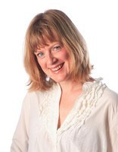
Kate Nation Prof of Experimental Psychology

Slide 27
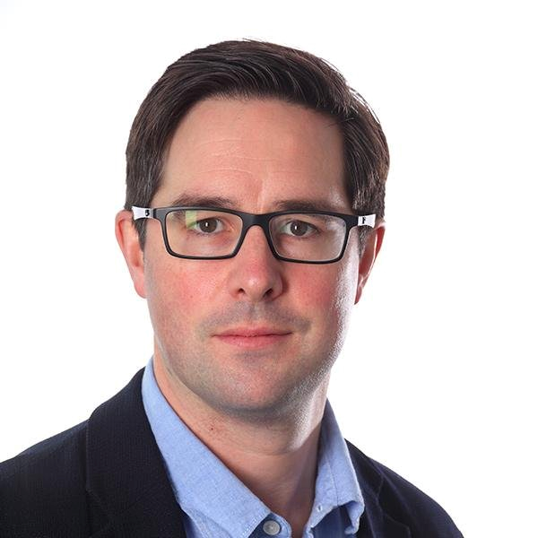
William Whyte Prof of Social and Architectural History

Slide 28
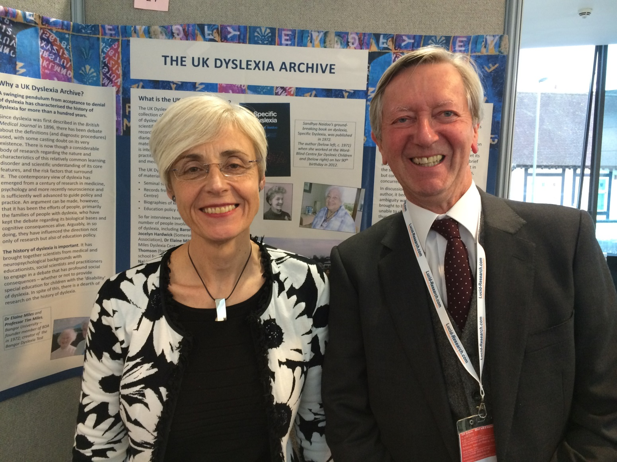
Launch of the Archive plan, 2014

Slide 29
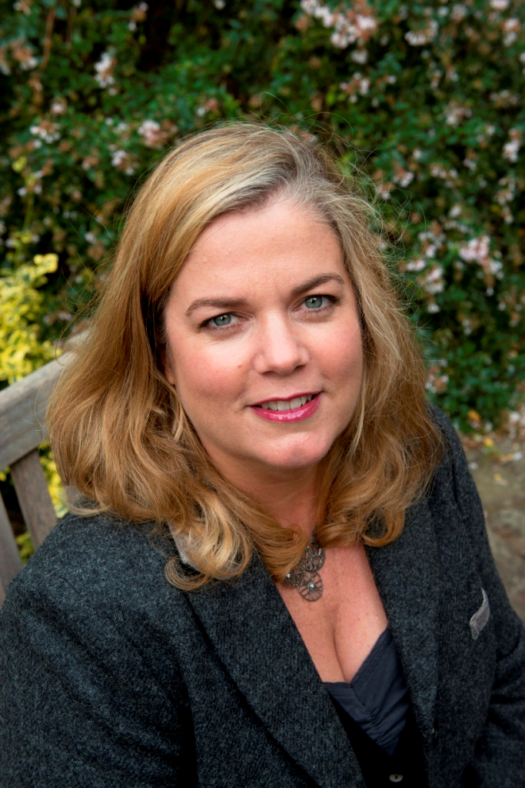
Victoria Murphy Prof of Applied Linguistics

Slide 30
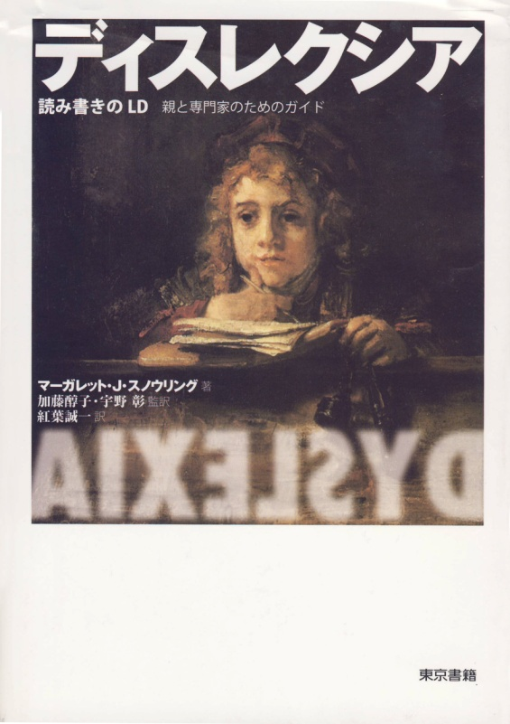
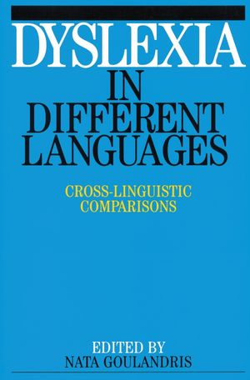
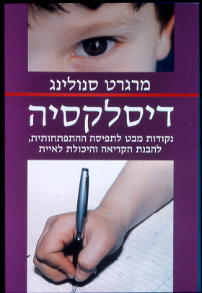
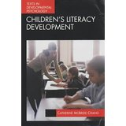
Cross-linguistic Perspectives

Slide 31
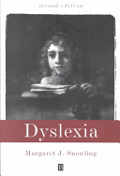
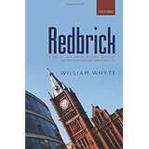
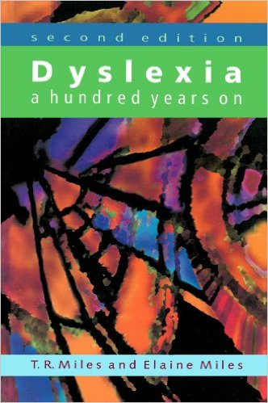
William Whyte, Maggie Snowling, Kate Nation and Robert Evans (University of Oxford), with dyslexia expert Steve Chinn, will take forward the project.
If you have material that could be included in the UK Dyslexia Archive or would like to suggest people who might offer an oral history, please fill in our questionnaire or contact president@sjc.ox.ac.uk.

